Slide 1
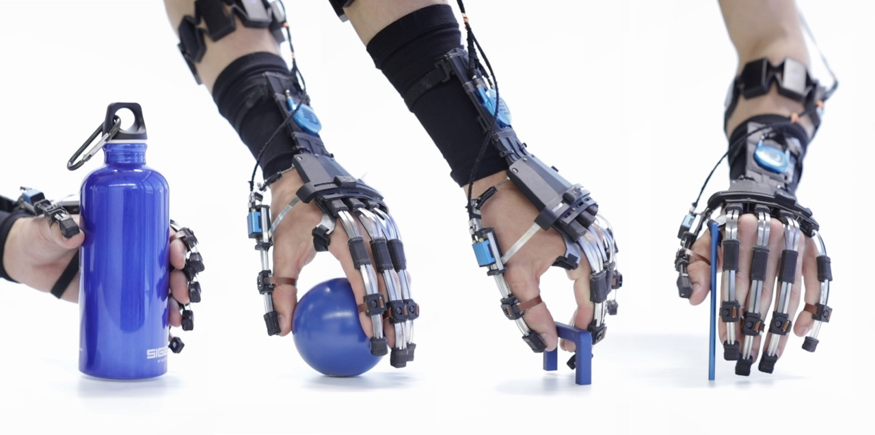
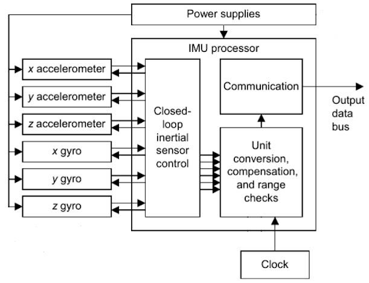
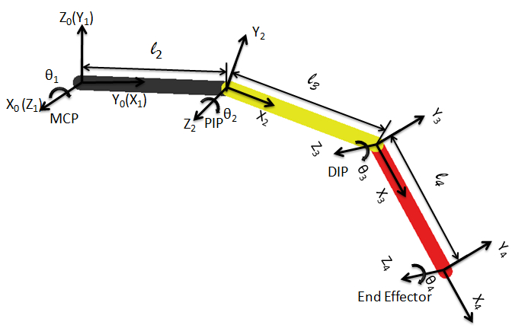
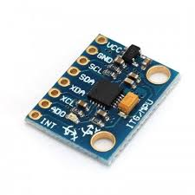
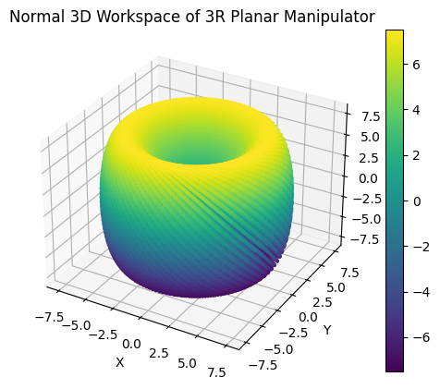
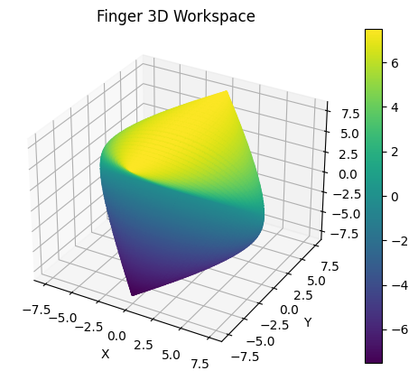
A Kalman Filtering Approach To Improve The Accuracy Of Accelerometry Based Finger Pose Tracking
A. Professor K.P Ayodele and Miracle Igbunu Eghrudje (EEG/2017/047)
Obafemi Awolowo University (Electronic and Electrical Engineering)
ABSTRACT
LITERATURE REVIEW
Data Acquisition:
Obtained raw accelerometer and gyroscope readings from MPU6050 via Arduino Microcontroller.
Utilized Kalman filter in Python to process data and output roll and pitch values.
Constructed kinematic equations using Denavit convention and sensor roll values to calculate joint poses in 3D space.
Mini Robot Experiment:
Conducted Mini-robot experiment to validate Kalman algorithm's accuracy in reconstructing angular positions from accelerometer data.
Objectives included verifying the precision of Kalman filtering and evaluating reconstructed angular positions.
Filtering Approach:
Applied Kalman filtering to enhance accelerometer data for precise finger pose estimation.
Addressed challenges such as sensor noise and uncertainties in IMU data.
Leveraged Pykalman python library for implementation.
Inertial Measurement Unit (IMU):
- Employed MPU6050 6-axis accelerometer/gyroscope sensors on finger joints.
- Utilized gyroscopes to measure rotational velocity and accelerometers to measure acceleration.
- Strategically positioned sensors for comprehensive finger movement tracking.
RESULTS
Finger pose tracking is vital for rehabilitation therapies targeting hand and finger motion. This study proposes employing Kalman filters to enhance accuracy in noisy accelerometer data, crucial for precise finger pose determination.
By combining data from three MPU6050 sensors, joint inclination angles in 3D space are captured. Kalman filters adaptively adjust predictions, providing robust estimates even in dynamic systems with multiple sources of noise.
Experimental validation demonstrates the effectiveness of this method, promising significant improvements in finger rehabilitation therapies by enabling accurate progress tracking and treatment effectiveness assessment.
The mini-robot experiment is at its concluding stage as at the time of preparing this poster. However final inference is not yet reached.
Currently I am conducting analysis on the data stored in the csv files to see if indeed the Kalman filter algorithm in use was able to accurately construct the angular displacement of the sensors strapped to the arm of the rotating robot.
 | Sensor Fusion Technique | System | Sensor
Paper1 | Extended Kalman Filter | Finger | Markers
Paper2 | Variants Of Kalman Filter | Human arm | MPU6050
Paper3 | Magwick Algorithm | Hand And Finger | IMU Sensor
CONCLUSION
METHODOLOGY
I have been able to build the pipeline that acquires raw data from the MPU6050 sensor(s), construct accurate state estimate(orientation) using Kalman filter on the raw data and use derived kinematic equations to obtain pose of finger joints in 3D space. I also have been able to setup an experiment with a mini robot to validate the operation of the Kalman filter. Further analysis will be conducted on the data acquired from the experiment and proper inference will be made concerning the performance of the Kalman filter solution.
METHODOLOGY
MPU6050 sensor(s)
Kalman Filter
Kinematic Equations
(Derived From Denavit
Parameters)
Kinematic Representation:
Utilized Denavit-Hartenberg (DH) parameters to model finger motion.
Incorporated metacarpal and phalangeal joints for flexion/extension.
Established coordinate systems to describe finger motion dynamics accurately.
REFERENCES
Alfian, R. I., Ma'arif, A., & Sunardi, S. (2021). Noise reduction in the accelerometer and gyroscope sensor with the Kalman filter algorithm. Journal of Robotics and Control (JRC), 2(3), 180-189.
Guler, R. A., Neverova, N. and Kokkinos, I. (2018), Densepose: Dense human pose estimation in the wild, in ‘Proceedings of the IEEE conference on computer vision and pattern recognition’, pp. 7297-7306.
Kownacki, C. (2011). Optimization approach to adapt Kalman filters for the real-time application of accelerometer and gyroscope signals’ filtering. Digital Signal Processing, 21(1), 131–140. https://doi.org/10.1016/J.DSP.2010.09.001
OBJECTIVES
The project aims to provide a system that accurately measures the finger pose of wearable hand orthosis.
The objective of this study is to leverage the advantages of Kalman filters to obtain reliable and real-time finger pose estimates for hand orthosis.
By combining data from three MPU6050 sensors strategically positioned at proximal, interphalangeal, and distal joints, we aim to derive accurate joint inclination angles in 3D space. These angles serve as crucial variables for calculating the overall finger pose.
3 Link Finger Model
ACKNOWLEDGMENT
I would like to acknowledge my supervisor Associate Professor K.P Ayodele for his immense support, guidance and mentorship during the course of this research.
Notes:
IMU

